Slide 1
VR Conference
Soft Dev With VR & Gaming
Supervisor – DR Conor Keighrey
By Daniel V

Slide 2
Objective
To Develop an application for businesses / education
Multiple users at a time using photon
Can draw / write on the whiteboard with different marker styles
Presentee & Presenter can move around the scene
Hand tracking

Slide 3
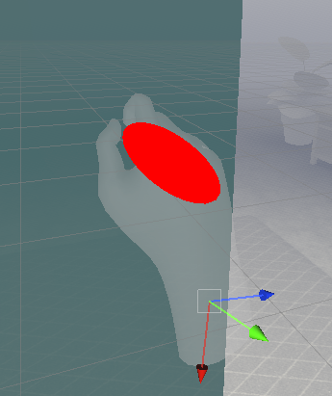
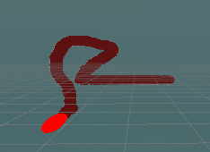
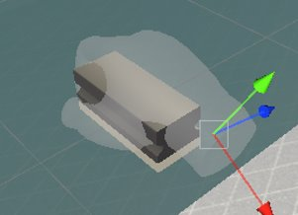
Work done in the last deliverable
Marker
Sphere object with rigid body, collider and scripts to allow grab with the pinch technique to be used
Whiteboard
A blank plane with its own shader, camera and texture
Duster
3D asset from google
Bottom layer set transparency to 0

Slide 4

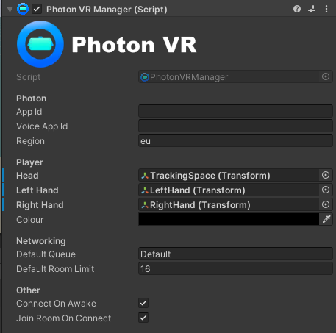
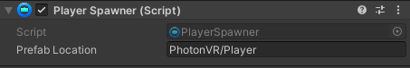

Work done since then
Multiplayer
This was created using Photon Pun 2 and Photon Voice 2.
Afterwards 3 game objects were added, Photon Manager, Voice and Player.
New account was created in photon website to create a new Pun server and Voice server.
Head was set to center eye transform.
Left & right hand set to users left and right-hand controller.

Slide 5
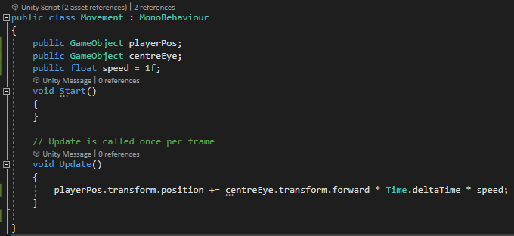
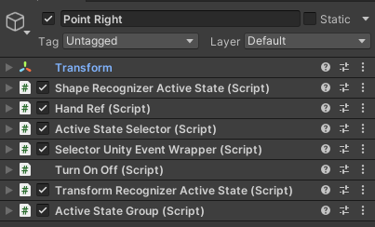
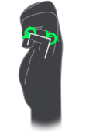
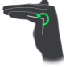
Work done since then
Movement
Created a script to allow the user to move in the direction they are facing.
Froze players rotation
Hand pose
Created a pose object that set the curl and flexion of the index finger to open.
In transform recognizer, the palm facing down is set to world space and true.
Now the application recognizes the users' right hand, pointing their index finger out.
Combining the two
In event wrapper the turn on and off script is set active when the finger is pointed which turns on the movement script.

Slide 6
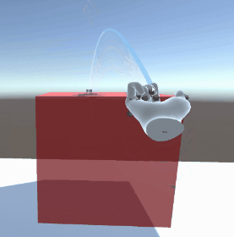
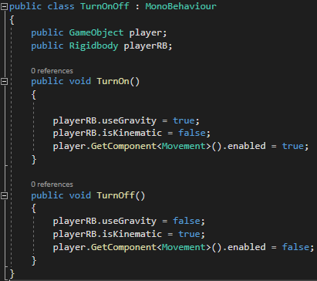
Issues and old ideas
MRTK teleportation
Combining MRTK finger teleportation with oculus hand tracking was working well, however only the users’ camera would teleport, leaving behind their hands in one place.
Object transfer
Photon transfer set to takeover in photon view.
Along side other scripts like photon rigid body view, photon transfer view and shared simple mover script.
Users' velocity jump
When the user stops moving, they were shot into the air.
Collision detection set to continues speculative.
This was fixed by making the user kinematic when they stopped moving, and turning on gravity when they move again.

Slide 7
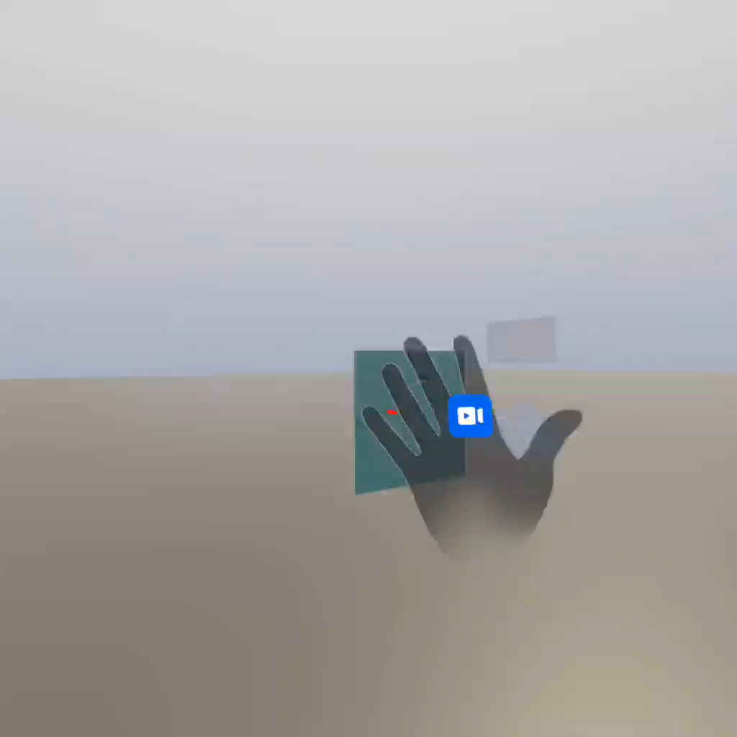
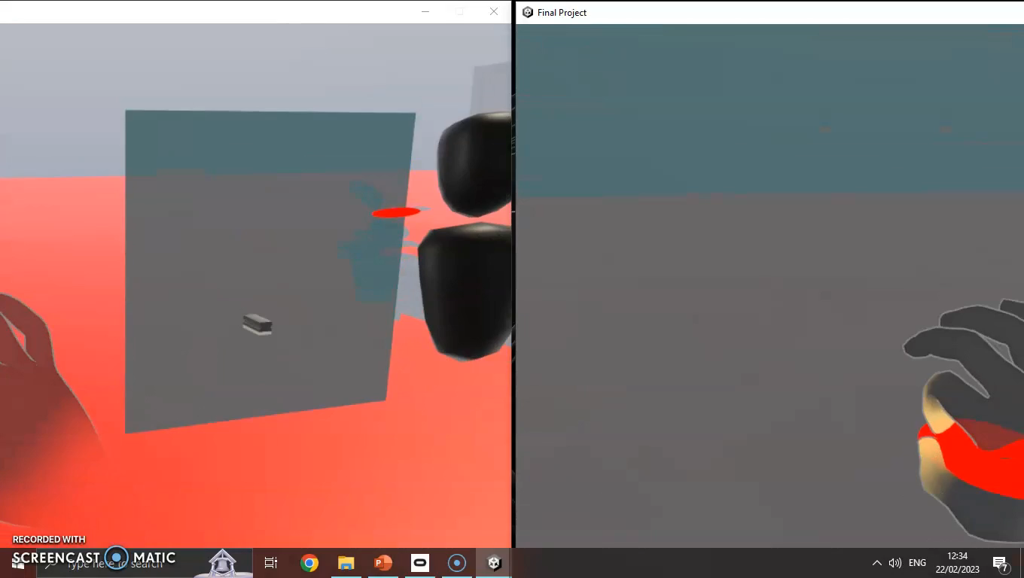
Multiplayer Demo
Movement Demo

